Slide 1


A Global Linear Method for Camera Pose Registration
Nianjuan Jiang*¹, Zhaopeng Cui*², Ping Tan²
¹Advanced Digital Sciences Center, Singapore
²National University of Singapore
*Joint first authors

Slide 2
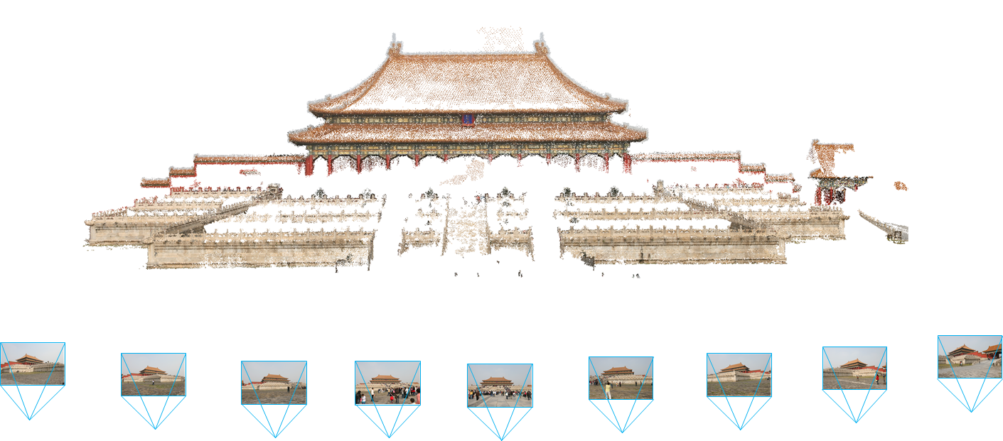
Structure from Motion (SfM)
Simultaneously recover both 3D scene points and camera poses

Slide 3
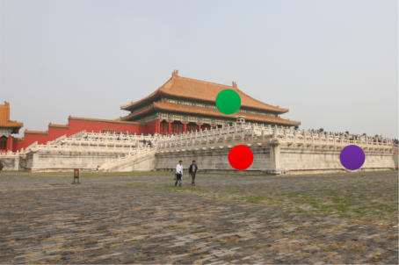
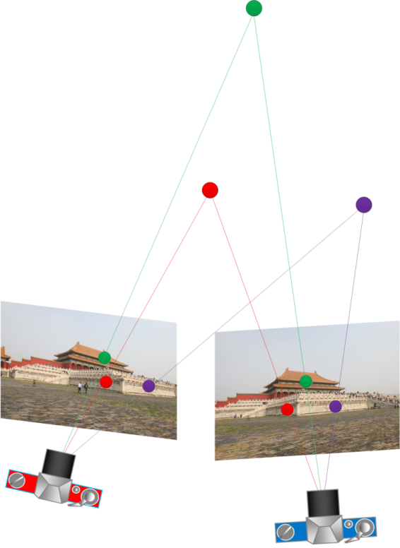
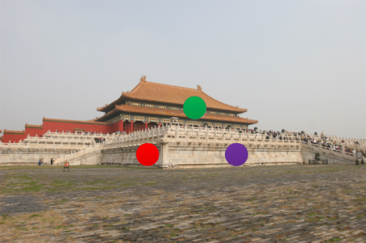
SfM Pipeline
Step 1. Epipolar geometry; compute relative motion between 2 or 3 cameras
6-point method [Quan 1995]
7-point method [Torr & Murray 1997]
8-point method (normalized) [Hartley 1997]
5-point method [Nister 2004]
Images with matched feature points

Slide 4

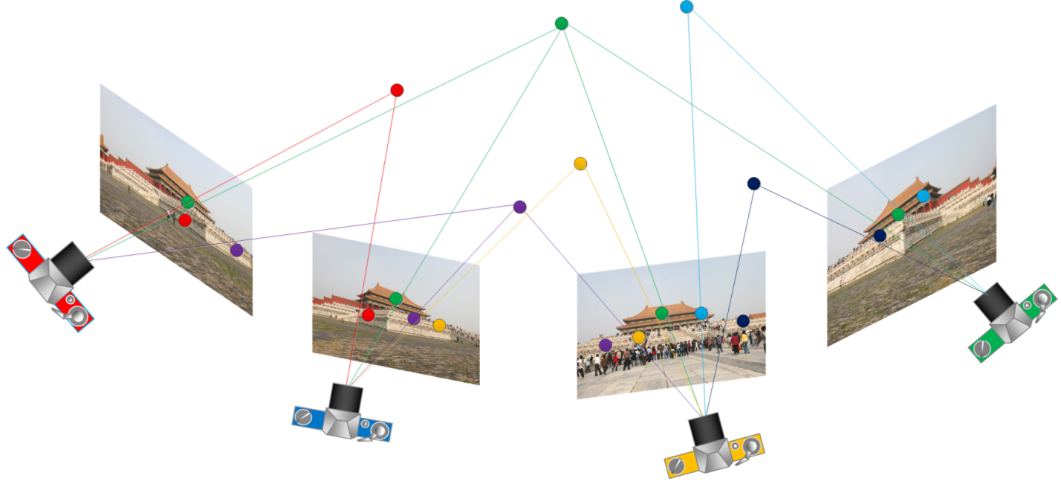
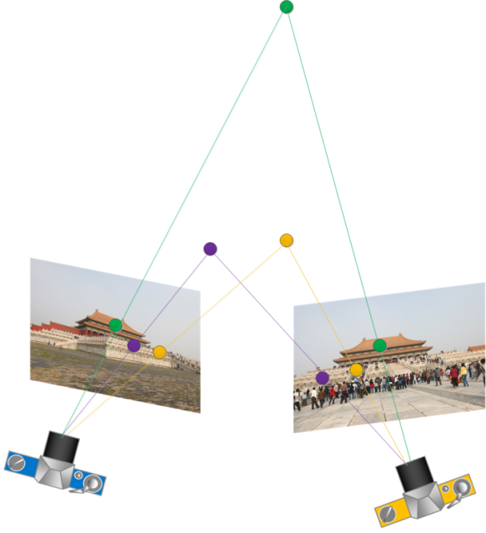
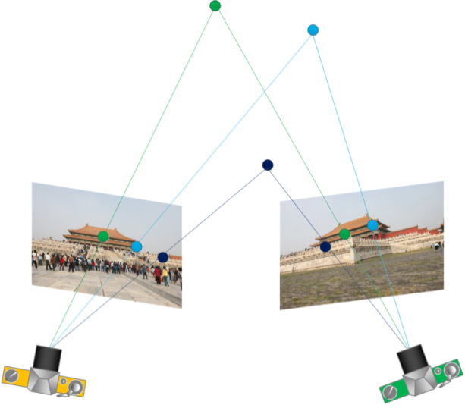
SfM Pipeline
Step 1. Epipolar geometry;
Step 2. Camera registration; put all cameras in the same coordinate system
(auto-calibration if needed [Pollefeys et al. 1998])
[Fitzgibbon & Zisserman 1998]
[Pollefeys et al. 2004]

Slide 5
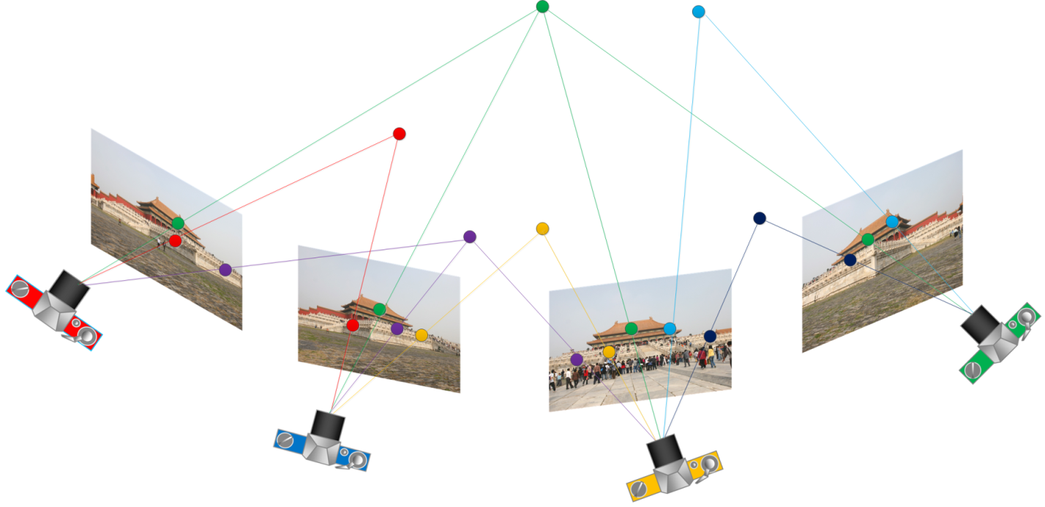
SfM Pipeline
Step 1. Epipolar geometry;
Step 2. Camera registration;
Step 3. Bundle adjustment. optimize all cameras and points
[Triggs et al. 1999]

Slide 6

“The Black Art ”
Step 1. Epipolar geometry;
Step 2. Camera registration;
Step 3. Bundle adjustment.
The state-of-the-art:
Step 1 and 3 are very well studied with elegant theories and algorithms.
The step 2 is often ad-hoc and heuristic.
The camera registration to initialize bundle adjustment “… is still to some extent a black art…”.
Page 452, Chapter 18.6

Slide 7
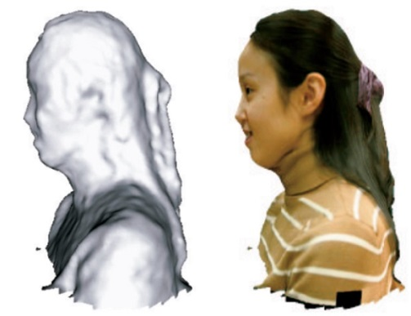
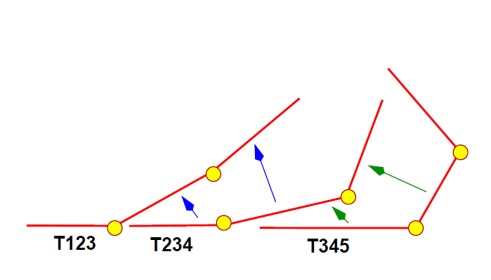
Typical Solutions
Hierarchical solution:
Iteratively merge sub-sequences
[Fitzgibbon & Zisserman 1998]
[Lhuillier & Quan 2005]

Slide 8

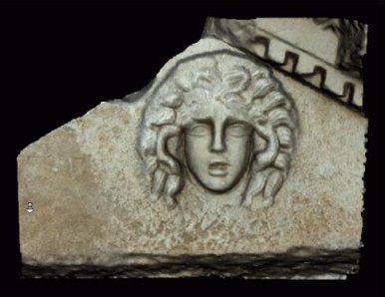
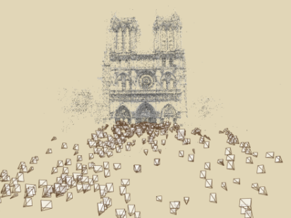
Typical Solutions
Hierarchical solution:
Iteratively merge sub-sequences
Incremental solution:
Iteratively add cameras one by one
[Fitzgibbon & Zisserman 1998]
[Lhuillier & Quan 2005]
[Pollefeys et al. 2004]
[Snavely et al. 2006]

Slide 9
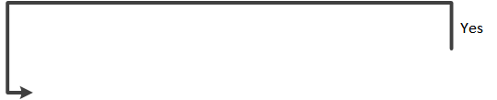
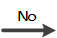
Pain of Existing Solutions
The block diagram (for the incremental solution):
Drawbacks:
Repetitively calling bundle adjustment ➔ Inefficiency
90% of the total computation time is spent on bundle adjustment.
Some cameras are fixed before the others
asymmetric formulation leads to inferior results.
Our objective:
Simultaneously register all cameras to initialize the bundle adjustment

Slide 10
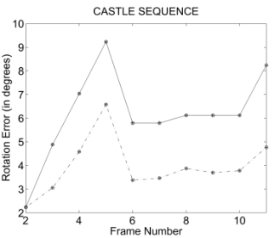
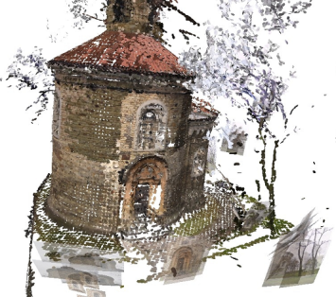
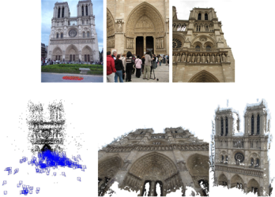
Previous Works
linear global solution to rotations
discrete-continuous optimization
cannot solve translations
require coplanar cameras
[Govindu 2001]
Desirable features:
Solve both rotations & translations;
Linear & robust solution;
No degeneracy.
[Hartley et al. 2013]
[Crandall et al. 2011]
elegant quasi-convex optimization
linear global solution to translations
sensitive to outliers
degenerate at collinear motion
[Kahl 2005]
[Martinec et al. 2007]
[Arie-Nachimson et al. 2012]

Slide 11

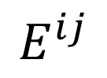
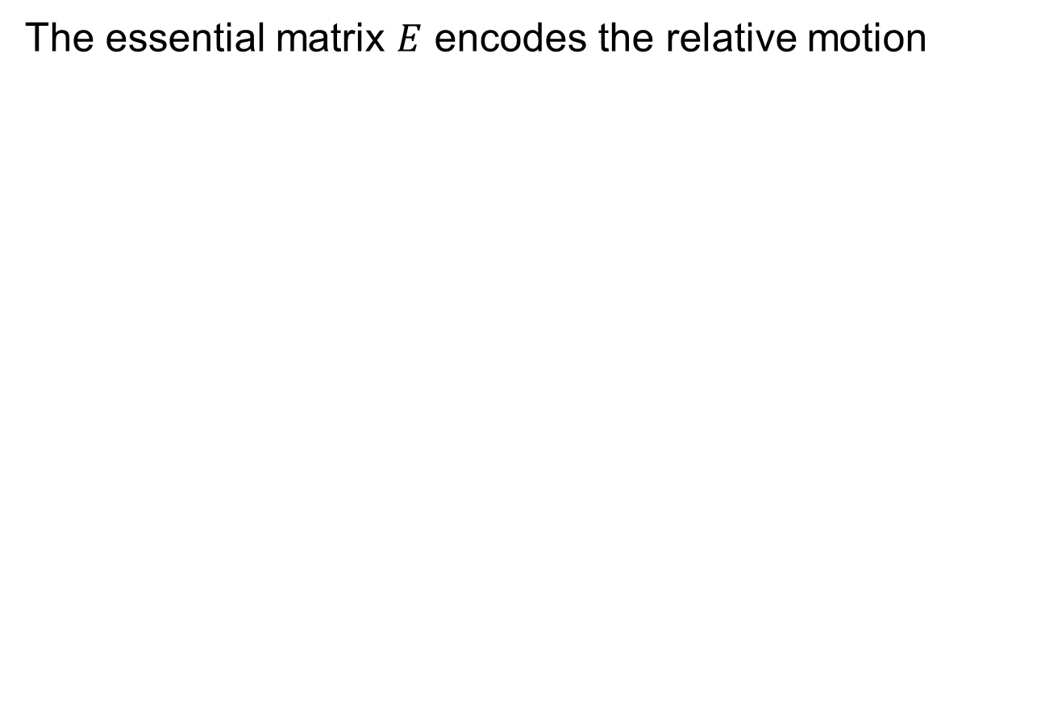
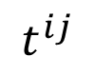
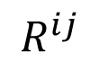
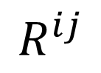
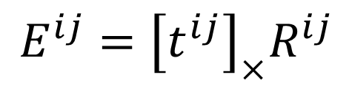
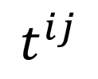
The Input Epipolar Geometry
The essential matrix $E$ encodes the relative motion
$${E^{ij}={\left[t^{ij}\right]}_{×}R}^{ij}$$
$$E^{ij}$$
$$R^{ij}$$
and
$$t^{ij}$$
$$t^{ij}$$
$$R^{ij}$$

Slide 12
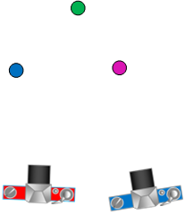
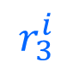
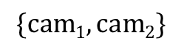

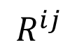

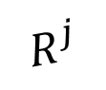

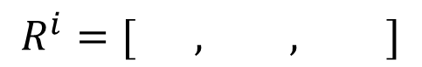

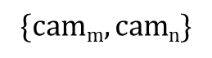
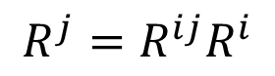

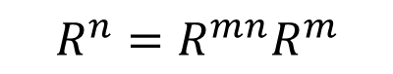
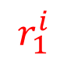

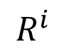
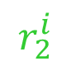
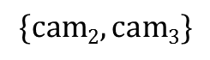
Rotation Registration
[Martinec et al. 2007]
A linear equation from every two cameras
$$R^{i}=[ , , ]$$
$$r_{1}^{i}$$
$$r_{2}^{i}$$
$$r_{3}^{i}$$
$$\{cam1,cam2\}$$
$$R^{2}=R^{12}R^{1}$$
$$\{cam2,cam3\}$$
$$R^{3}=R^{23}R^{3}$$
$$R^{ij}$$
$$⨀$$
$$…$$
$$…$$
$$R^{j}$$
$$⨀$$
$$R^{i}$$
$$\{camm,camn\}$$
$$R^{n}=R^{mn}R^{m}$$
$$R^{j}=R^{ij}R^{i}$$

Slide 13
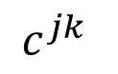
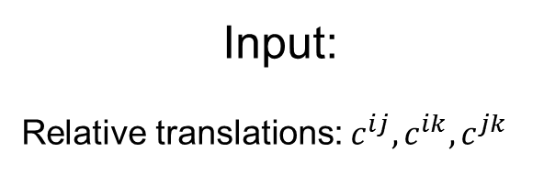
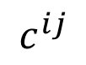
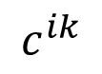
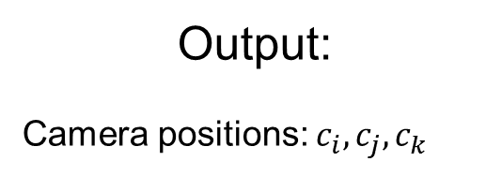
Translation Registration (3 cameras)
Input:
Relative translations: $c^{ij}, c^{ik}, c^{jk}$
Output:
Camera positions: $c_{i}, c_{j}, c_{k}$
c_{k}
$$c^{ik}$$
$$c^{jk}$$
c_{i}
$$c^{ij}$$
c_{j}

Slide 14
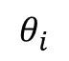
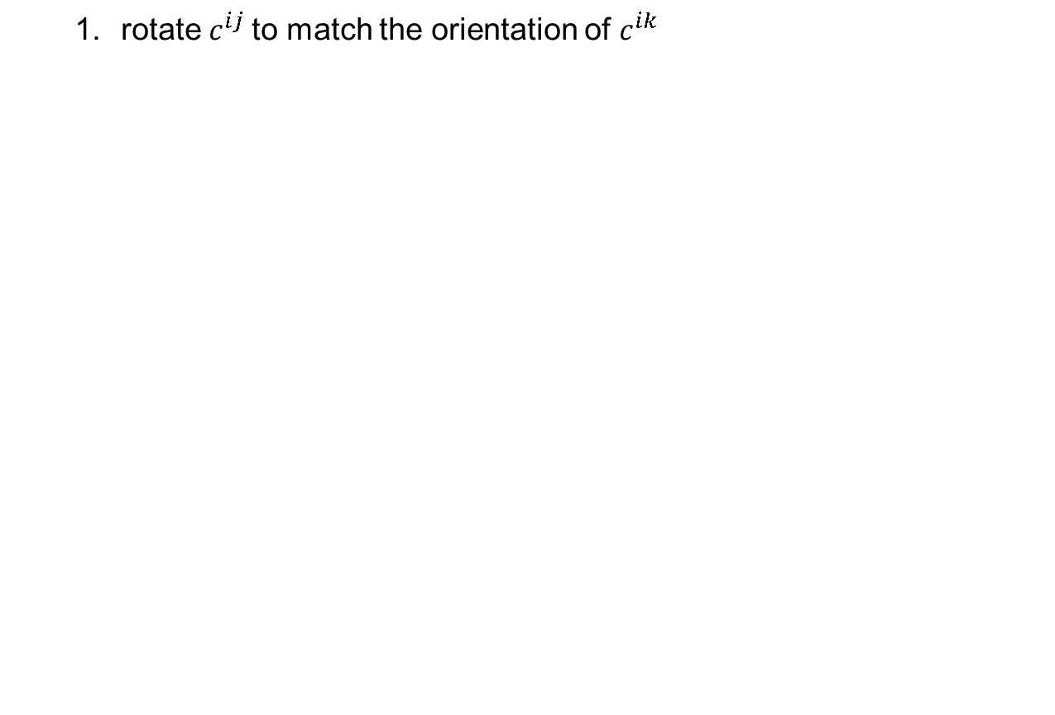
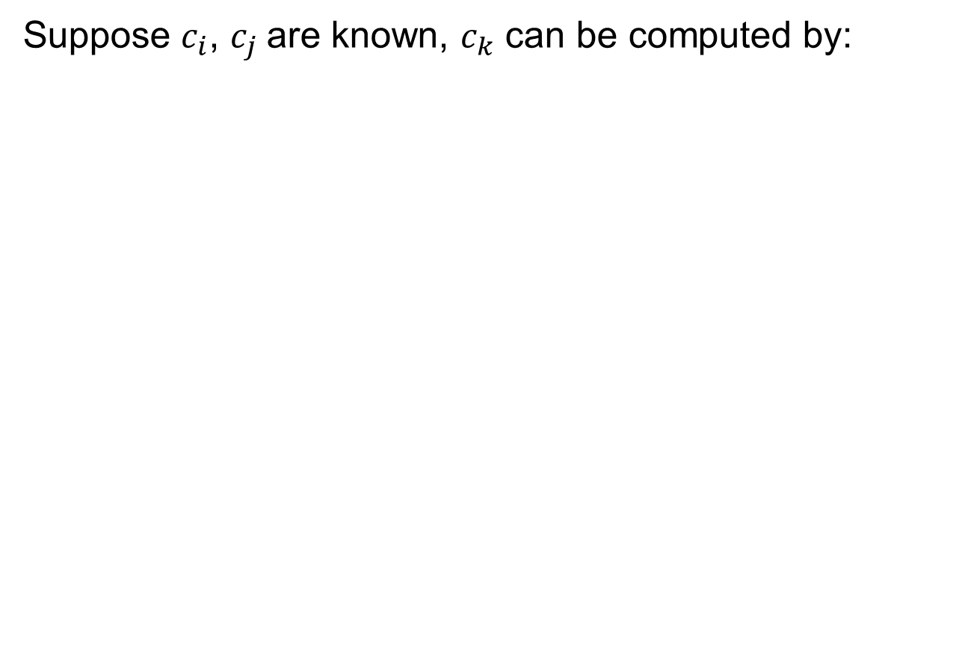
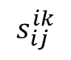

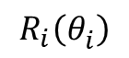
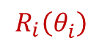
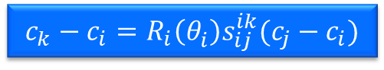
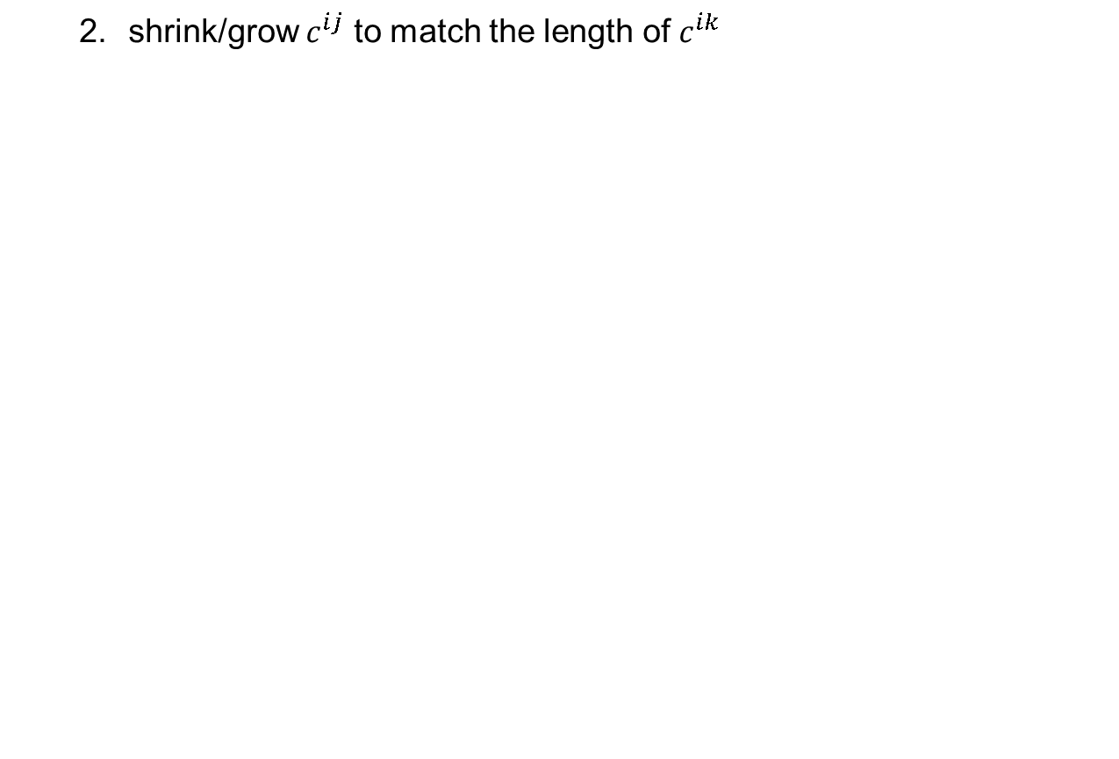
Translation Registration (3 cameras)
Suppose $c_{i}$, $c_{j}$are known, $c_{k}$ can be computed by:
both are easy to compute
rotate $c^{ij}$to match the orientation of $c^{ik}$
$$R_{i}\left(θ_{i}^{}\right)$$
shrink/grow $c^{ij}$ to match the length of $c^{ik}$
$$s_{ij}^{ik}$$
$$s_{ij}^{ik}$$
A linear equation:
$$c_{k}−c_{i}={R_{i}\left(θ_{i}^{}\right)s}_{ij}^{ik}(c_{j}−c_{i})$$
$$R_{i}\left(θ_{i}^{}\right)$$
c_{k}
$$c^{ik}$$
$$θ_{i}^{}$$
c_{i}
$$c^{ij}$$
c_{j}
c_{j}

Slide 15



Translation Registration (3 cameras)
A similar linear equation by matching $c^{ij}$and$c^{jk}$
$$c_{k}−c_{j}={R_{j}\left(−θ_{j}^{}\right)s}_{ij}^{jk}(c_{i}−c_{j})$$
c_{k}
$$c^{jk}$$
$$θ_{j}^{}$$
c_{i}
c_{i}
$$c^{ij}$$
c_{j}

Slide 16







Translation Registration (3 cameras)
A geometric explanation
$π_{1}$: plane spanned by $c_{ij}$ and $c_{ik}$
$$c_{k}−c_{i}={R_{i}\left(θ_{i}^{}\right)s}_{ij}^{ik}(c_{j}−c_{i})$$
$π_{2}$: plane spanned by $c_{ij}$ and $c_{jk}$
$$c_{k}−c_{j}={R_{j}\left(−θ_{j}^{}\right)s}_{ij}^{jk}(c_{i}−c_{j})$$
$π_{1}$and $π_{2}$ are non-coplanar
$$π_{1}$$
c_{k}
$$π_{2}$$
c_{i}
c_{j}

Slide 17








Translation Registration (3 cameras)
A geometric explanation
$$c_{k}−c_{i}={R_{i}\left(θ_{i}^{}\right)s}_{ij}^{ik}(c_{j}−c_{i})$$
$$c_{k}=c_{i}+{R_{i}\left(θ_{i}^{}\right)s}_{ij}^{ik}(c_{j}−c_{i})$$
$$≈A$$
$$c_{k}−c_{j}={R_{j}\left(−θ_{j}^{}\right)s}_{ij}^{jk}(c_{i}−c_{j})$$
$$c_{k}=c_{j}+{R_{j}\left(−θ_{j}^{}\right)s}_{ij}^{jk}(c_{i}−c_{j})$$
$$≈B$$
see derivation in the paper
$$π_{1}$$
$$π_{2}$$
$AB$: the mutual perpendicular line
A
c_{k}
B
$c_{k}$: the middle point of $AB$
Our linear equations minimizes an approximate geometric error!
c_{i}
c_{j}

Slide 18






Translation Registration (3 cameras)
No degeneracy with collinear motion
c_{k}
$$c^{ik}$$
$$c^{jk}$$
c_{i}
$$c^{ij}$$
c_{j}
$$c_{k}−c_{i}={R_{i}\left(0\right)s}_{ij}^{ik}(c_{j}−c_{i})$$
$$c_{k}−c_{j}={R_{j}\left(0\right)s}_{ij}^{jk}(c_{i}−c_{j})$$

Slide 19




Translation Registration (3 cameras)
Suppose $c_{i}$, $c_{k}$are known, $c_{j}$can be computed by:
$$c_{j}−c_{i}=R_{i}\left(−θ_{i}^{}\right) s_{ik}^{ij}(c_{k}−c_{i})$$
$$c_{j}−c_{k}=R_{k}\left(θ_{k}\right)s_{ik}^{jk} (c_{i}−c_{k})$$
c_{k}
$$c^{ik}$$
$$θ_{k}^{}$$
$$c^{jk}$$
$$θ_{i}^{}$$
c_{i}
$$c^{ij}$$
c_{j}

Slide 20



Translation Registration (3 cameras)
Suppose $c_{j}$, $c_{k}$are known, $c_{i}$can be computed by:
$$c_{i}−c_{k}=R_{k}\left(−θ_{k}^{}\right) s_{jk}^{ik}(c_{j}−c_{k})$$
$$c_{i}−c_{j}=R_{j}\left(θ_{j}\right)s_{jk}^{ij} (c_{k}−c_{j})$$
c_{k}
$$c^{ik}$$
$$θ_{k}^{}$$
$$c^{jk}$$
$$θ_{j}^{}$$
c_{i}
$$c^{ij}$$
c_{j}

Slide 21


Translation Registration (3 cameras)
Collecting all six equations
$$c_{k}−c_{i}={R_{i}\left(θ_{i}^{}\right)s}_{ij}^{ik}(c_{j}−c_{i})$$
$$c_{k}−c_{j}={R_{j}\left(−θ_{j}^{}\right)s}_{ij}^{jk}\left(c_{i}−c_{j}\right)$$
$$c_{j}−c_{i}={R_{i}\left({−θ}_{i}^{}\right)s}_{ik}^{ij}(c_{k}−c_{i})$$
$$c_{j}−c_{k}={R_{k}(θ_{k}^{})s}_{ik}^{jk}(c_{i}−c_{k})$$
$$c_{i}−c_{j}={R_{j}\left(θ_{j}^{}\right)s}_{jk}^{ij}(c_{k}−c_{j})$$
$$c_{i}−c_{k}={R_{k}({−θ}_{k}^{})s}_{jk}^{ik}(c_{j}−c_{k})$$
$$B_{ijk}\left(\begin{matrix}c_{i} \\ c_{j} \\ c_{k}\end{matrix}\right)=0$$

Slide 22

















Translation Registration (n cameras)
Generalize to n cameras
1. Collect equations from all triangles in the match graph.
$$Y=\left[\begin{aligned}c_{1} \\ c_{2} \\ c_{3} \\ c_{4} \\ c_{5} \\ c_{6} \\ c_{7} \\ c_{8} \\ c_{9}\end{aligned}\right]$$
The match graph:
each camera is a vertex,
connect two cameras if their relative motion is known.
$$BY=0$$
2. Solve all equations
$$B_{1}\left(c_{1},c_{2},c_{3}\right)=0$$
cameras can be non-coplanar.
$$B_{2}\left(c_{2},c_{3},c_{4}\right)=0$$
$$B\left(c_{3},c_{4},c_{6}\right)=0$$
$$B_{4}\left(c_{4},c_{5},c_{6}\right)=0$$
$$B_{5}\left(c_{5},c_{6},c_{7}\right)=0$$
$$B_{6}\left(c_{6},c_{7},c_{8}\right)=0$$
$$B_{7}\left(c_{7},c_{8},c_{9}\right)=0$$

Slide 23
Triangulation
Once cameras are fixed, triangulate matched corners to generate 3D points.

Slide 24





Robustness Issues
Exclude unreliable triplets
More consistency checks in the paper
$$c^{ij}={\hat{c}}^{ij}$$
$$c^{ik}={\hat{c}}^{ik}$$
$$c^{jk}={\hat{c}}^{jk}$$
Check if ??
$$c^{ik}$$
$$c^{jk}$$
$${\hat{c}}^{ik}$$
$${\hat{c}}^{jk}$$
$$c^{ij}$$
$${\hat{c}}^{ij}$$

Slide 25



Results
Accuracy evaluation:
Compare with recent methods on data with known ground truth.
Fountain-P11
Herz-Jesu-P25
Castle-P30
 | Fountain-P11 |  | Herz-Jesu-P25 |  | Castle-P30
 | c meters | R degrees | c meters | R degrees | c meters | R degrees
Ours | 0.0139 | 0.1954 | 0.0636 | 0.1880 | 0.2345 | 0.4800
[Arie-Nachimson et al. 2012] | 0.0226 | 0.4211 | 0.0479 | 0.3125 | - | -
[Sinha et al. 2010] | 0.1317 | - | 0.2538 | - | - | -
VisualSFM | 0.0364 | 0.2794 | 0.0551 | 0.2868 | 0.2639 | 0.3980
All results are after the final bundle adjustment.

Slide 26




Results
Efficiency evaluation:
Building
Notre Dame
Pisa
Trevi Fountain
 | Building (128) |  | Notre Dame (371) |  | Pisa (481) |  | Trevi Fountain (1259)
 | Our Method | Visual-SFM | Our Method | Visual-SFM | Our Method | Visual-SFM | Our Method | Visual-SFM
Total running time (s)* | 17 | 62 | 49 | 479 | 69 | 479 | 135 | 1790
BA time (s) | 11 | 57 | 20 | 442 | 52 | 444 | 61 | 1715
Registration time (s) | 6 | 5 | 29 | 37 | 17 | 12 | 74 | 75
# of reconstructed images | 128 | 128 | 362 | 365 | 479 | 480 | 1255 | 1253
# of reconstructed points | 91,290 | 78,100 | 103,629 | 104,657 | 134,555 | 129,484 | 297,766 | 292,277
* The total running time excludes the time spent on feature matching and epipolar geometry computation.

Slide 27

Conclusions
A global solution for orientations & positions;
Linear, robust & geometrically meaningful;
No degeneracy.

Slide 28
Thanks!
code & data available at:
http://www.ece.nus.edu.sg/stfpage/eletp/

Slide 29

Results
A large scale scene
Quasi-dense points generated by CMVS [Furukawa et al. 2010] for better visualization.

